Slide 1
NICU BABY MONITOR
A PROJECT BASED ON BABY MONITORING

Slide 2
PREFACE
IN THIS BUSY LIFE THE CARE WHAT WE GIVE TO THE INFANT ARE LESS CONCENTRATED . WE FORGET THE FUTURE REST ON THEM .WE FEEL TO CONNECT THE LIFE WITH THEM CONCERATED MONITORING SYSTEM…

Slide 3
MISSION KEY STONES
CAMERA & ITS SPECIFICATIONS
DVR & MEDIA ENCODER SETUP
LIVE STREAM & ONLINE STORAGE
WEB PAGE & ACCESS STRUCTURE
SERVER SCRIPTING
OTP & CARRIER
DATA BASE MANAGEMENT
DOUBT BOX

Slide 4
CAMERA & ITS SPECIFICATIONS
A PROJECT BASED ON BABY MONITORING

Slide 5
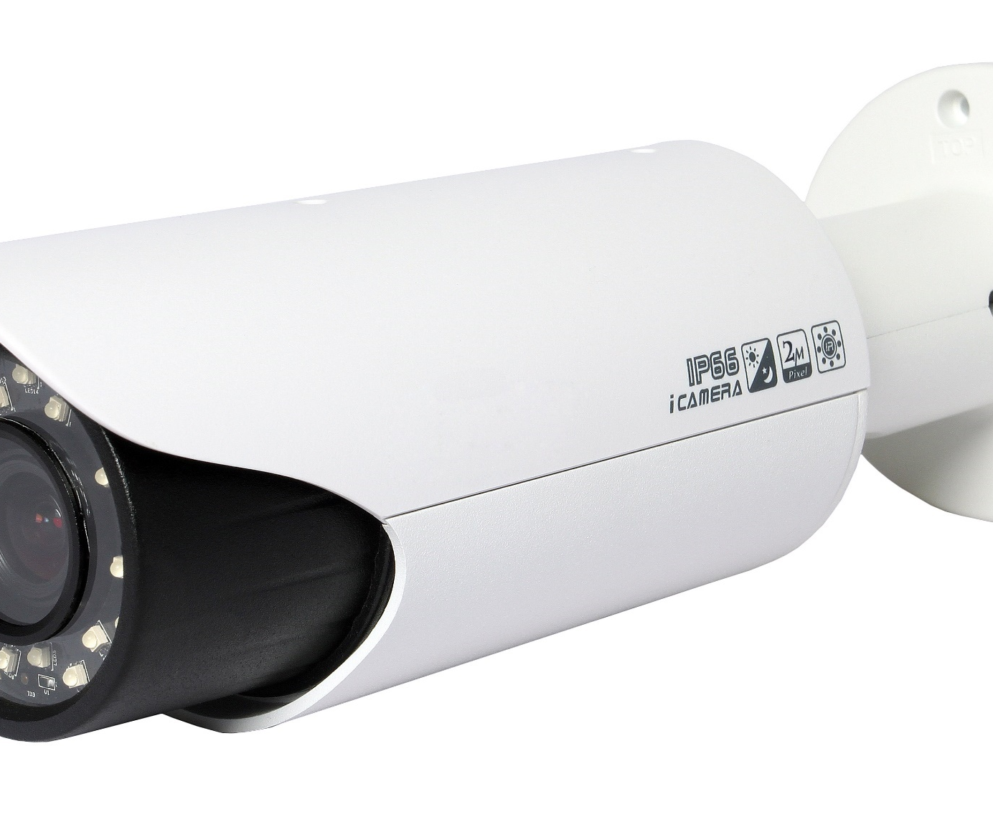
CAMERA
DIGITAL BULLET CAMERAS
NIGHT VISION
IP66
TACTILE SENSOR
RESOLUTION

Slide 6
DVR & MEDIA ENCODER SETUP
A PROJECT BASED ON BABY MONITORING

Slide 7
DVR & MEDIA ENCODER SETUP
THE DVR COLLECT THE FOOTAGE & STORE … THEN ENCODER SETUP CHANGE THE VIDEO FORMAT AND GETS READY FOR STREAMING.
DVR
4 VIDEO CHANNEL & A AUDIO CHANNEL
LOCAL MONITOR OUT
LOCAL PC OUT
MEDIA ENCODER
THE VIDEO FROM THE DVR IS PROCESSED & ENCODED TO STREAMING FORMATS FOR EASY STREAMING TRANSMISSION.

Slide 8
LIVE STREAM & ONLINE STORAGE
A PROJECT BASED ON BABY MONITORING

Slide 9
LIVE STREAM & ONLINE STORAGE
A HIGH INTERNET SPEED CONNECTION AS 1:4 PORT FOR UPLOADING FROM CONCERN ISP PROVIDERS .
A LIVE STREAMING WEBSITE 3 PAGE STREAMING TOTAL ABOUT 10 PAGES.
ONLINE STORAGE DRIVE ABOUT 10 TB.
(MAY CHANGE ACORDANCE WITH NO OF BABIES)

Slide 10
WEB PAGE & ACCESS STRUCTURE
A PROJECT BASED ON BABY MONITORING

Slide 11
WEB PAGES
DESCRIBE ABOUT EACH PAGE AND ITS IMPORTANCE
HOME PAGE
THE PAGE WHICH GIVE INDEX OUT FOR ALL OTHER LINKS.
ABOUT US
THIS PAGE DESCRIBE ABOUT THE MISSION & ITS OBJECTIVE.
CONTACT
FOR CONTACTING DEVELOPER & FOR SERVICE REAL TIME SUPPORT EMAIL FORM.

Slide 12
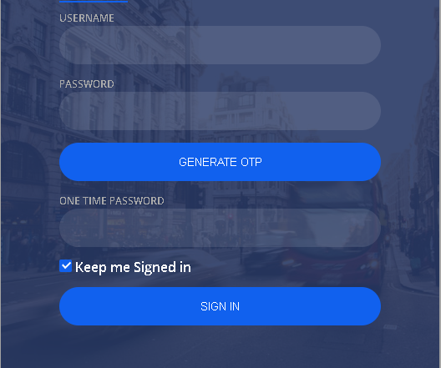
LOGIN SECTION
* ADMINSTRATOR LOGIN
* HOSPITAL LOGIN
* CLIENT USER LOGIN

Slide 13
LOGIN CONTROL FLOW
ADMINSTRATOR LOGIN
DEFINE THE HOSPITAL LOGIN ID
HOSPITAL LOGIN
DEFINE THE CLIENT USER LOGIN ID
CLIENT USER LOGIN
LOGIN WITH THE ID & OTP
OVER ALL CONTROL
CONTROL OVER USER & VIEW
CAN VIEW …
REPORT THE FEED BACK

Slide 14
SERVER SCRIPTING
A PROJECT BASED ON BABY MONITORING

Slide 15
SERVER SCRIPTING
LOGIN PHP
TRIPLE LAYER LOGIN STRUCTURE IS BUILT IN, SECURE LOG IN TRANSMISSION.
STEAMING PHP
THIS SCRIPT MAKES ACTIVE STREAMING PHP.
RANDOM OTP PHP
TIME BASED WITH MATHMATICAL OPERATION BASED 6 DIGIT CODE.
REAL TIME SUPPORT PHP
REAL TIME 3 CONTACT FORMS WITH EMAILING CAPABLITY & SMS.
LOGIN PHP
STEAMING PHP
RANDOM OTP PHP
REAL TIME SUPPORT PHP

Slide 16
OTP & CARRIER
A PROJECT BASED ON BABY MONITORING

Slide 17
OTP & CARRIER
THE OTP IS CONSTRUCTED AND SEND OVER TO THE CLIENT
WE ARE TAKING AN EXTERNAL CARRIER FOR SMS. THIS SHOULD BE PURCHASED WITH ACORDANCE WITH NO MESSAGE, WE SENT PER MONTH AND WITH THE TRUST IN CARRIER AS WE SEND OUR OTP THROUGH IT.

Slide 18
DATA BASE MANAGEMENT
A PROJECT BASED ON BABY MONITORING

Slide 19
DATA BASE MANAGEMENT
WE ARE USING SQL DATA BASE SYSTEM .
WE SHOULD HAVE THREE DATABASE .
CLIENT USER LOGIN DATA BASE
HOSPITAL LOGIN DATA BASE
OTP ONE TIME PASSWORD
DATA BASE | IMPORTANCE
CLIENT | BABY WISE USERS & LOGIN DETAILS
HOSPITAL | HOSPITAL WISE USERS & LOGIN DETAILS
OTP | EASY MIX CODE FOR RANDOM OTP

Slide 20
DOUBT BOX
A PROJECT BASED ON BABY MONITORING

Slide 21
DOUBT BOX
THE DOUBTS TO BE CLEARED FOR BETTER MOVES………
DO WE NEED STORAGE PLAY BACK SYSTEM ?
RESOLUTION OF CAMERA ?
MOTION CAPTURE ANALAYSIS ?

Slide 22
THANKS
HERE WE END WITH THE REPORT…………………

